Slide 1






Introduction to AI
Group No. - 7
Branch - CSE(AI)
Section - C

Slide 2





Team Members:
Mohammad Dilshad(202401100300153)
Sachin Kumar(202401100300208)
Nikhil Kumar(202401100300160)
Rahul Kumar Gupta(202401100300191)
Sachin Kumar(202401100300207)

Slide 3



Project Name :
Personality prediction using MBTI dataset

Slide 4
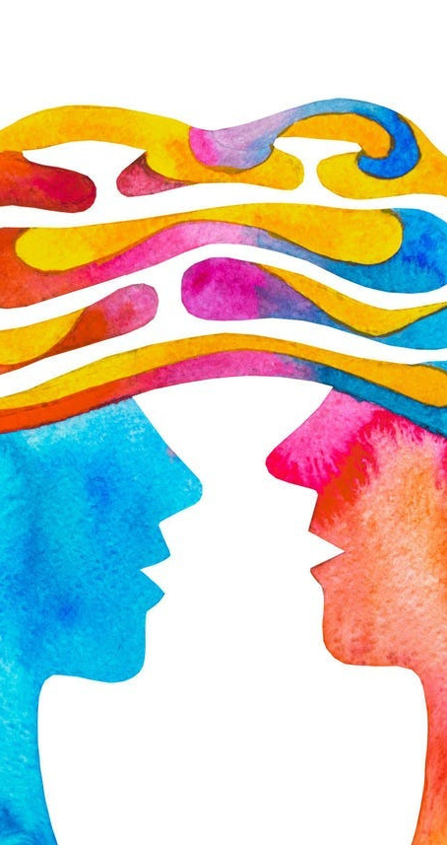

Problem Statement:
Use NLP techniques to classify personality types based on users? written text.
Implement text preprocessing and natural language understanding.

Slide 5
Introduction:
In the era of digital communication, people frequently express their thoughts, feelings, and preferences through written text on social media, blogs, forums, and chat platforms. These textual footprints carry significant clues about an individual's personality traits. Understanding personality from text has numerous applications, including personalized marketing, recruitment, mental health assessment, and recommender systems.
This project leverages Natural Language Processing (NLP) techniques to classify a user's MBTI personality type from their written text. By analyzing language patterns, word choices, and semantic structures, it becomes possible to make accurate predictions about a person's psychological characteristics.
The system involves several key steps, including:
• Text preprocessing (cleaning and normalizing data),
• Feature extraction (using TF-IDF or transformer-based embeddings),
• Model training (with machine learning or deep learning algorithms), and
• Prediction of personality labels.

Slide 6



Methodology:
The methodology for predicting personality types from text involves a pipeline of processes that transform raw textual data into personality predictions using Natural Language Processing (NLP) and Machine Learning techniques.
Data Collection
The dataset used contains written text samples from individuals labeled with their MBTI (Myers-Briggs Type Indicator) personality types. A commonly used dataset is the MBTI Kaggle dataset, which includes thousands of text posts with corresponding MBTI labels
Each data entry includes:
• Text: A collection of user-generated posts.
• Label: One of the 16 MBTI personality types
Text Preprocessing
Raw text data is often noisy and unstructured. Preprocessing ensures the input is clean, normalized, and ready for feature extraction.
Steps include:
• Lowercasing: Convert all text to lowercase.
• Removing URLs, mentions, and special characters: Strip out irrelevant elements like hyperlinks and usernames.

Slide 7
Methodology:
Feature Extraction
The processed text is converted into a numerical format suitable for machine learning algorithms.
Two approaches are commonly used:
• TF-IDF Vectorization: Measures the importance of words in a document relative to a corpus.
• Transformer Embeddings: Uses pre-trained models like BERT or Sentence-BERT to generate semantic embeddings that capture contextual meaning.
• Label Encoding
• The MBTI personality types are categorical labels. These are encoded into numerical values using Label Encoding or One-Hot Encoding to make them compatible with classification models.
• Optionally, the prediction task can be broken down into four binary classification tasks, one for each personality dimension

Slide 8
Methodology:
Model Training
The extracted features and encoded labels are used to train machine learning models. Several algorithms can be employed:
• Baseline Models: Logistic Regression, Support Vector Machines (SVM), Random Forest.
• Deep Learning Models: LSTM, GRU, or Transformer-based models for capturing sequential patterns in text.

Slide 9


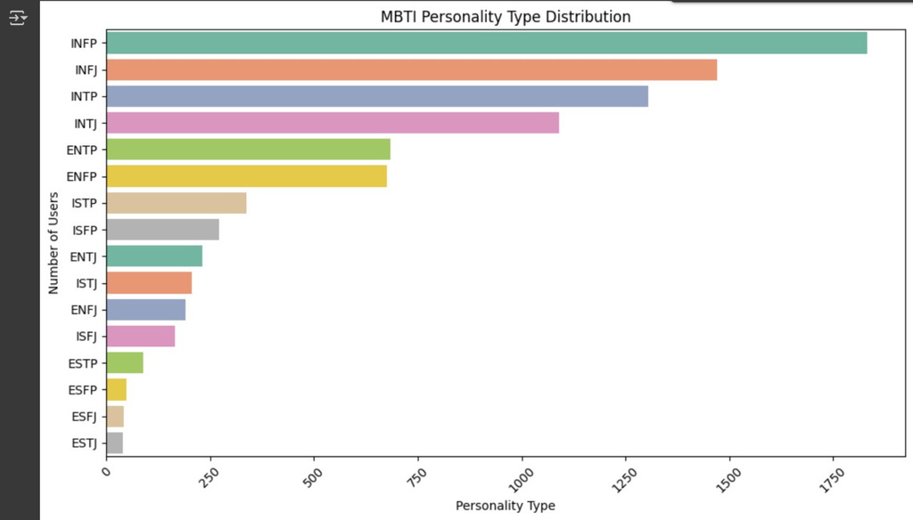
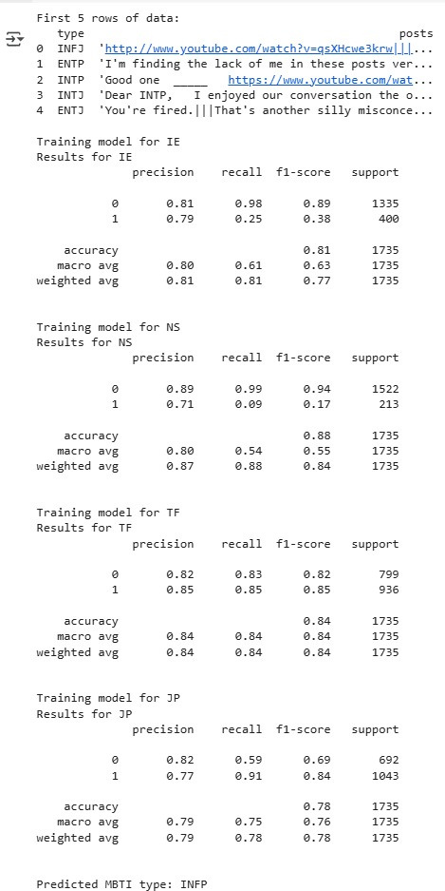
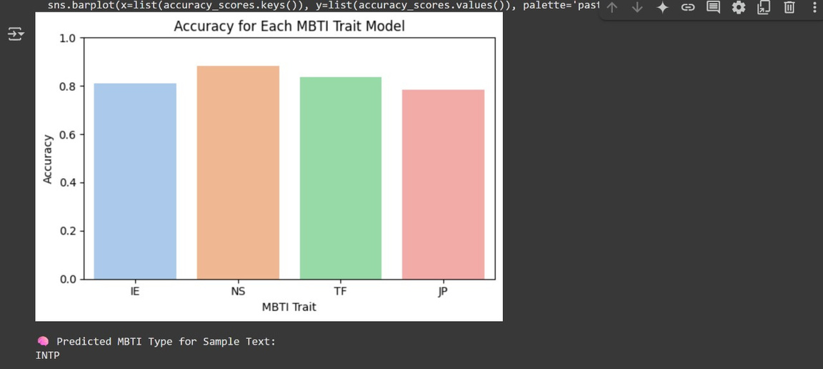
Output/Results:

Slide 10




REFERENCE:
Plank, B., Hovy, D., & Søgaard, A. (2014).
Personality traits on Twitter — Or how to get 1,500 personality tests in a week.
Proceedings of the 6th Workshop on Computational Approaches to Subjectivity, Sentiment and Social Media Analysis.
https://aclanthology.org/W14-2603
Yarkoni, T. (2010).
Personality in 100,000 Words: A large-scale analysis of personality and word use among bloggers.
Journal of Research in Personality, 44(3), 363–373.
https://doi.org/10.1016/j.jrp.2010.04.001

Slide 11
REFERENCE:
Golbeck, J., Robles, C., & Turner, K. (2011).
Predicting Personality with Social Media.
CHI '11 Extended Abstracts on Human Factors in Computing Systems.
https://doi.org/10.1145/1979742.1979614
Kaggle Dataset — MBTI Personality Type Dataset.
Datalab - MBTI Personality Prediction.
https://www.kaggle.com/datasnaek/mbti-type

Slide 12



THANK YOU

